Slide 2

Quick Poll
Who has used Cursor before?
Notes:
K

Slide 3
Quick Poll
2. Who uses LLMs (e.g. ChatGPT) regularly for work?
Notes:
K

Slide 4
Quick Poll
3. Who has experience with Prompt Engineering?
Notes:
K

Slide 5
Agenda
Introduction to AI Code Generation
Prompting Techniques – Theory
Practical: Snake Game Implementation
Lessons Learned & Pitfalls
Q&A
Notes:
Bingo erwähnen K (LG falls K einen mental breakdown hat)

Slide 6
What is a Prompt?
The sky is ...
Notes:
K

Slide 7

What is a Prompt?
The sky is ...
The sky is blue (during the day) and dark with stars at night.
Notes:
K

Slide 8
What is a Prompt?
The sky is ...
The sky is blue (during the day) and dark with stars at night.
The sky is vast and everchanging. What do you want me to explain about it?
Notes:
K

Slide 9

What is Prompt Engineering?
“Designing inputs for better outputs”
- Quote by ChatGPT-5
Logo: © OpenAI. Quelle: https://openai.com/brand
Verwendet gemäß den Markenrichtlinien von OpenAI
Notes:
K

Slide 10

Good Practices
If you get stuck
ask AI for a “radically different approach”
Provide screenshots
Ask AI to generate prompts („help me write better questions“)
Be specific!
Talk to AI like to a “Rubber Duck”
Notes:
K (die Ente habe ich schnell selbst gebaut :D)

Slide 11
ContextLanguageExampleAudienceRequest
Prompting Frameworks
„CLEAR“
CLEAR Framework: Conversational Language with Emphasis on Adaptable Results: Complete Guide with Examples | AiPromptsX
Notes:
K

Slide 12
ContextLanguageExampleAudienceRequest
Prompting Frameworks
“You work at a mid-sized AI company, as a team leader focusing on the rain-forest. (Context)
Use clear, professional language. (Language)
Include a phrase like ‘on track to meet the deadline’. (Example)
The audience is senior leadership. (Audience)
Summarize the project progress for a report. (Request) “
CLEAR Framework: Conversational Language with Emphasis on Adaptable Results: Complete Guide with Examples | AiPromptsX
Notes:
K

Slide 13
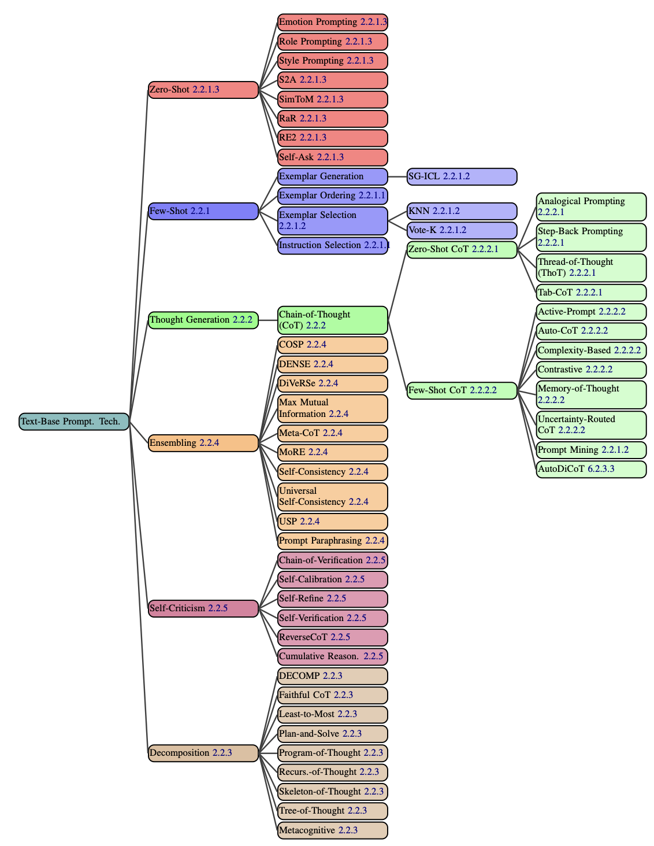
Prompt Engineering Techniques
Chain-of-Thought
Chain-of-Knowledge
Rephrase & Respond
Reflection Prompting
Self-Consistency
Cropped from Sahoo et. Al (2024), licensed CC-BY-SA 4.0 https://arxiv.org/abs/2402.07927
Cropped from Schulhoff et. al (2024), licensed CC-BY 4.0 https://arxiv.org/abs/2406.06608
Notes:
K

Slide 14



Chain-of-Thought
Idea: Ask the model to show reasoning steps
Why: Improves performance on complex, multi-step tasks. (--> Math!).
Paper: Wei et al. (2022) https://arxiv.org/abs/2201.11903
Notes:
L

Slide 15

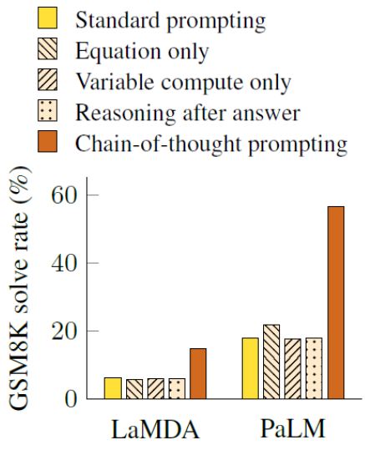
Chain-of-Thought
Standard Prompting
Model Input
Model Output
Q: Roger has 5 tennis balls. He buys 2 more cans of tennis balls . Each can has 3 tennis balls. How many tennis balls does he have now?
A: The answer is 11.
Q: The cafeteria had 23 apples. If they used 20 to make lunch and bought 6 more, how many apples do they have?
A: The answer is 27
Wei et al 2022, licensed CC-BY 4.0 https://arxiv.org/abs/2201.11903
Notes:
L

Slide 16

Chain-of-Thought
Chain of Thought Prompting
Model Input
Model Output
Q: Roger has 5 tennis balls. He buys 2 more cans of tennis balls . Each can has 3 tennis balls. How many tennis balls does he have now?
A: Roger started with 5 balls. 2 cans of tennis balls each is 6 tennis balls. 5 + 6 = 11. The answer is 11.
Q: The cafeteria had 23 apples. If they used 20 to make lunch and bought 6 more, how many apples do they have?
A: The cafeteria had 23 apples originally. They used 20 to make lunch. So they had 23 – 20 = 3. They bought 6 more apples, so they have 3 + 6 = 9. The answer is 9.
„Lets think this step by step“
Wei et al 2022, licensed CC-BY 4.0 https://arxiv.org/abs/2201.11903
Notes:
LaMDA und PaLM nachschauen links = few shot
Mitte = zero shot

Slide 17
Chain-of-Knowledge
Idea: Introduce relevant facts into the reasoning chain.
Why: Reduces hallucinations. Keeps reasoning grounded in facts.
Origin: Wang et al. (2023) arxiv.org/abs/2306.06427
Notes:
L

Slide 18
Chain-of-Knowledge
a) Standard ICL Prompting
b) Chain-of-Thought Prompting
c) Ours: Chain-of-Knowledge Prompting
Input
Input
Input
Q: Is the following sentence plausible? 'Joao Moutinho was out at third.‘
A: No.
Q: Is the following sentence plausible? 'Derrik White backhanded a shot.'
Q: Is the following sentence plausible? 'Joao Moutinho was out at third.‘
Joao Moutinho is a soccer player. Being out at third is part od baseball, not soccer.
A: No.
Q: Is the following sentence plausible? 'Derrik White backhanded a shot.'
Q: Is the following sentence plausible? 'Joao Moutinho was out at third.‘
Evidence triples: 1. (Joao, isA, soccer player) 2. (being out at third, is part of, baseball)
Explanation hints: Being out at third is part of baseball, yet, Joao Moutinho is a soccer player.
A: No.
Q: Is the following sentence plausible? 'Derrik White backhanded a shot.'
„Use Chain-of-Knowledge: evidence triplets (subject, relation, object)“
Output
Output
Output
A: Yes.
A: Yes, it is plausible. This sentence suggests that Derrik White, who is most likely a basketball or hockey player, made a backhanded shot attempt.
Evidence triples: 1. (Derrick White, isA, basketball player) 2. (backhanded shot, is commonly used in, hockey or tennis)
Explanation hints: Backhanded shot is commonly used in hockey or tennis, but not in basketball.
A: No.
Inspired by: Wang et al. 2024, licensed CC-BY 4.0 https://aclanthology.org/2024.acl-long.271/
Notes:
In Context Learning

Slide 19
Rephrase & Respond
Ask model to restate your question in different words.
Forces the model to clarify intent before generating content.
Idea: Ask model to restate your question in different words.
Why: Forces the model to clarify intent before generating content.
Paper: Deng et al. (2023) arxiv.org/2311.04205
Deng et al. (2023) arxiv.org/2311.04205
Notes:
LG

Slide 20
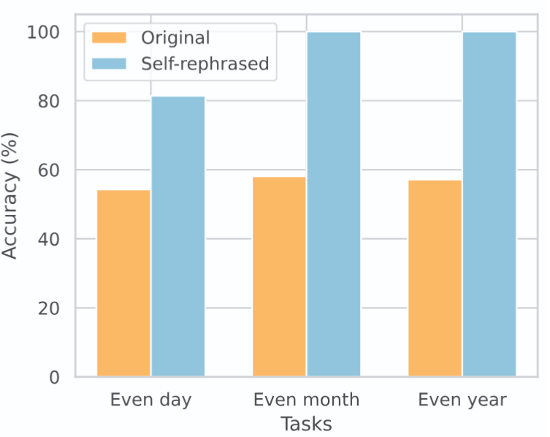
Rephrase & Respond
„Rephrase and expand the question and answer“
Original Question
Self-rephrased question
Was {person} born in an even day?
Was {person} born in an even month?
Was {person} born in an even year?
Could you provide more information on wether the individual named {person} was born on a day that is an even number? This refers to dates such as the 2nd, 4th, 6th, 8th, and so on within a given month.
Can you provide the specific month of the year in wich {person} was born to determine if it falls into an even-numbered month such as February, April, June, August, October, or December?
What is the birth year of {person} and is it an even number?
Inspired by: Deng et al. (2023) licensed CC-BY 4.0 arxiv.org/2311.04205
Notes:
Grafik quelle

Slide 21
Reflection Prompting
Idea: Ask the AI to review & improve its own output.
Why: Catches mistakes or gaps and improves quality by iterating over tasks/solutions
Paper: Shinn et al. (2023) https://arxiv.org/abs/2303.11366
Notes:
LG

Slide 22
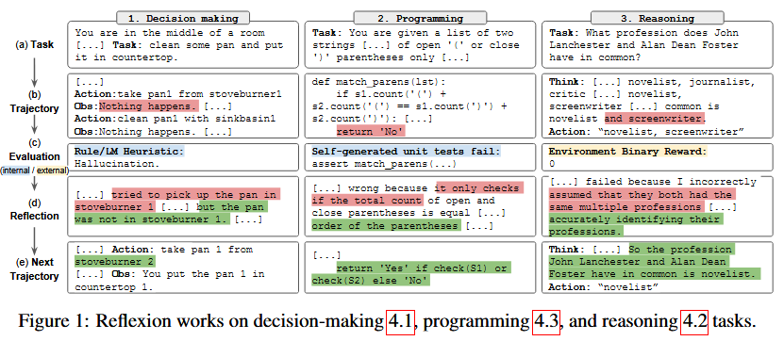
Reflection Prompting
Cropped from Shinn et al. (2023) CC-BY 4.0 https://arxiv.org/abs/2303.11366

Slide 23
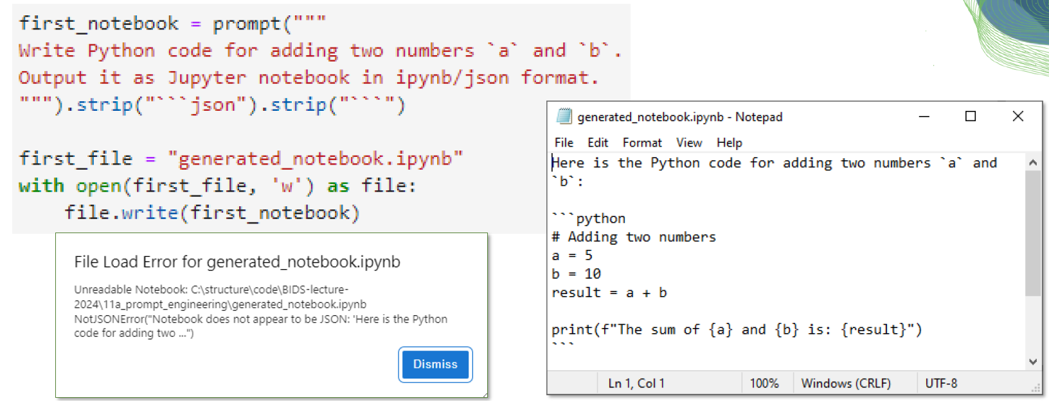
Reflection Prompting
Example task: Generate a Jupyter notebook
Cropped from Robert Haase, CC-BY 4.0 https://github.com/ScaDS/BIDS-lecture-2024/blob/main/11a_prompt_engineering/10_reflection.ipynb

Slide 24
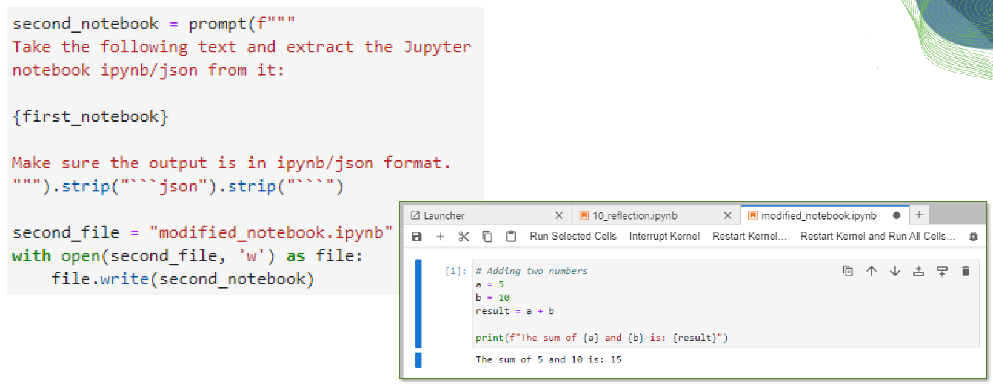
Reflection Prompting
Example task: Generate a Jupyter notebook
„Review and improve your own output“
Cropped from Robert Haase, CC-BY 4.0 https://github.com/ScaDS/BIDS-lecture-2024/blob/main/11a_prompt_engineering/10_reflection.ipynb

Slide 25
Self-Consistency
Idea: Generate multiple answers & keep the most consistent result.
Why: Reduces random errors. Improves robustness by filtering out bad reasoning paths.
Origin: Wang et al. (2022) https://arxiv.org/abs/2203.11171
Notes:
LG

Slide 26
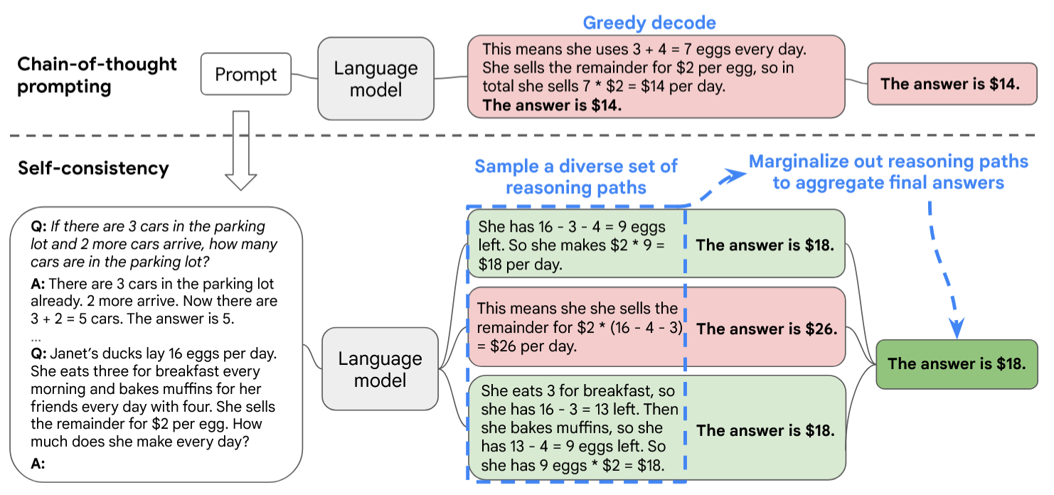
Self Consistency
ContextLanguageExampleAudienceRequest
„Generate multiple answers & keep the most consistent result“
Cropped from Zhang et al 2022, licensed CC-BY 4.0 https://arxiv.org/abs/2203.11171

Slide 27


Photo by Helena Forde on Unsplash
Photo by Umberto on Unsplash
Notes:
K

Slide 28
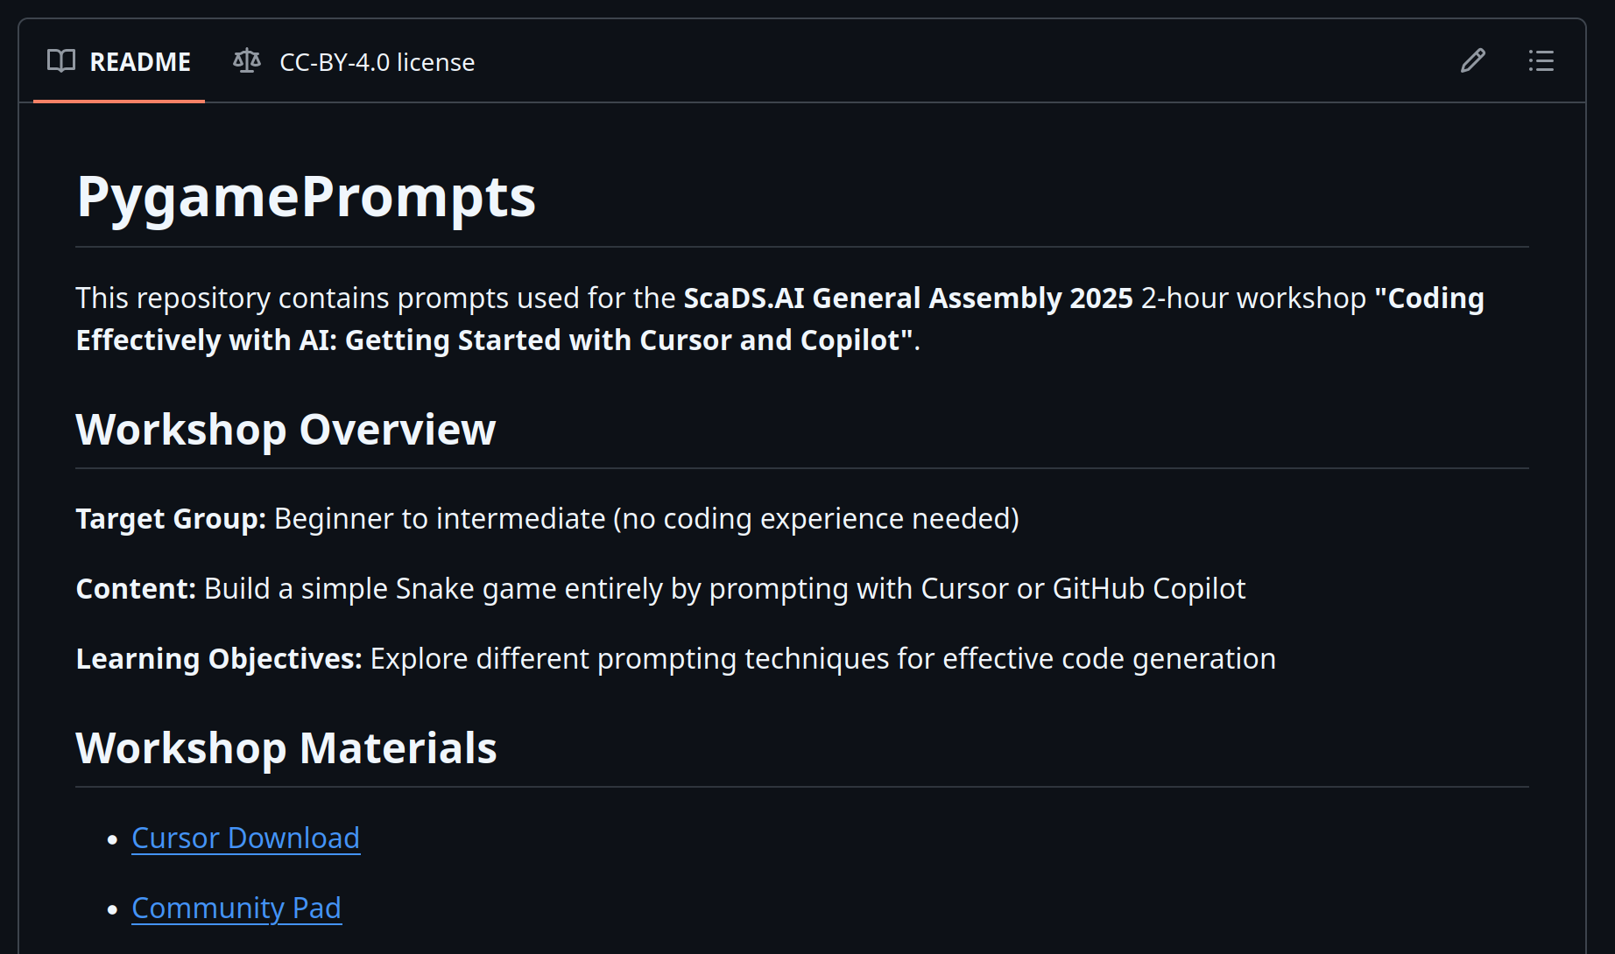
Go to Github...
https://github.com/kaabl/PygamePrompts
Notes:
K

Slide 29
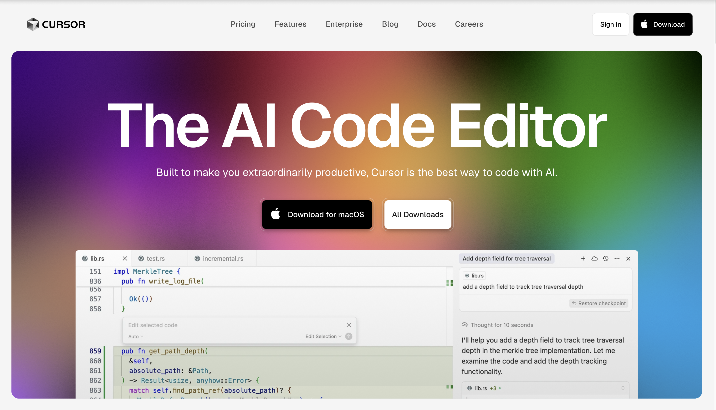

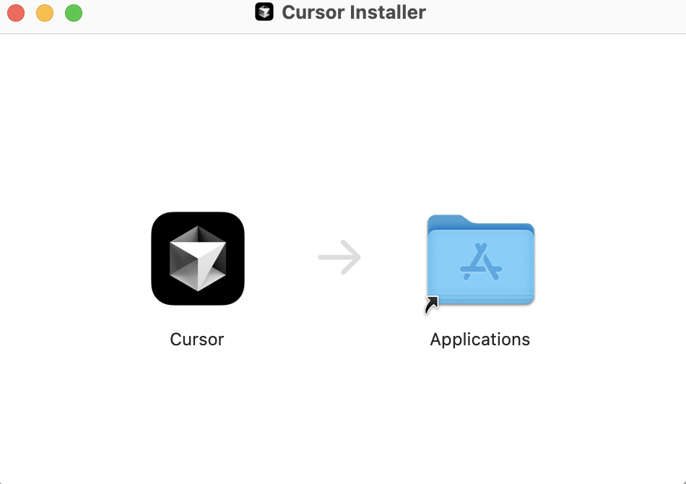
Cursor Installation (Mac)
Drag Cursor to Applications
Notes:
K

Slide 30
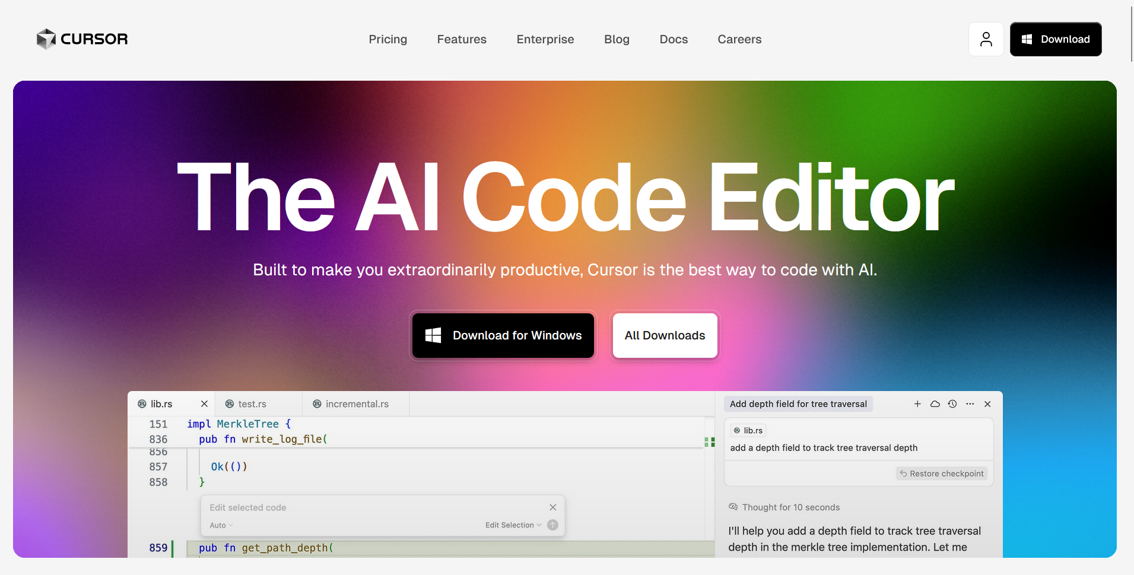

Cursor Installation (Windows)
Follow instructions in the setup window
Notes:
K

Slide 31
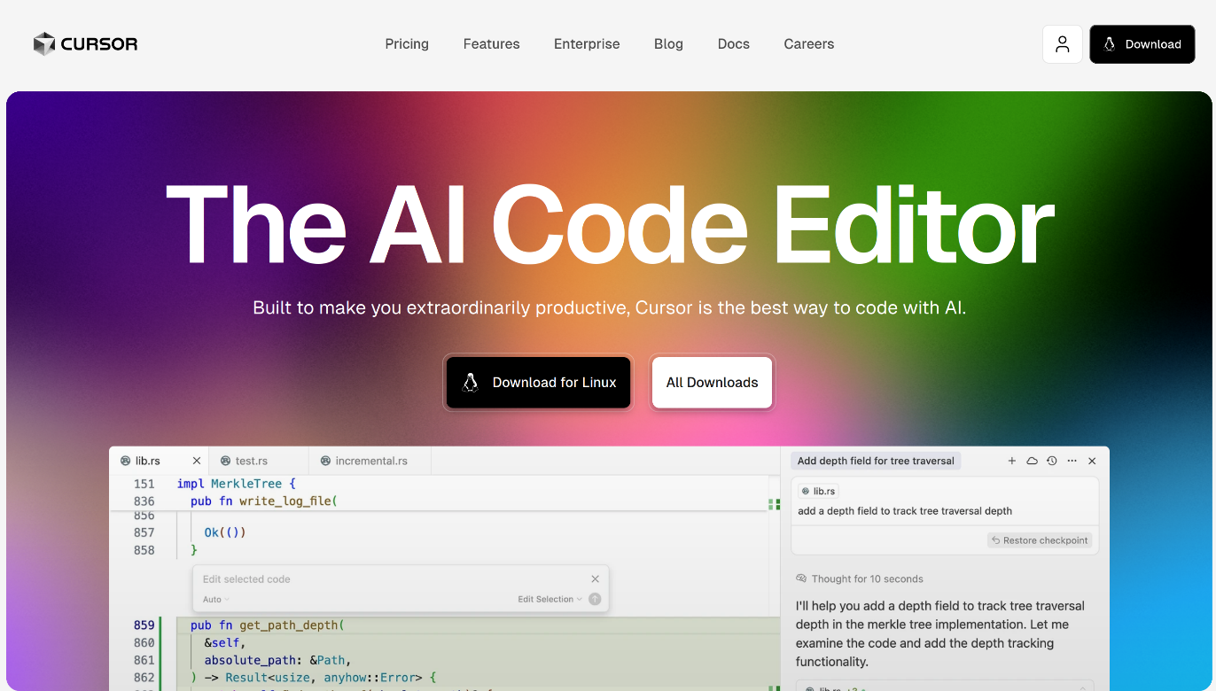
Cursor Installation (Linux)
Follow instructions in the GitHub repo
https://github.com/kaabl/PygamePrompts
Notes:
Link repo

Slide 32
Practical
Lets build a snake game using cursor:
https://github.com/kaabl/PygamePrompts

Slide 33
Pitfalls and Limitations
Ethical & Legal Risks | Quality & Reliability | Bias & Integrity | Practical Limitations
Data Privacy Entering information into AI tools can create risks of data leakage or misuse | Hallucinations AI can produce code that looks valid but is incorrect, nonfunctional, or based on nonexistent functions/libraries | Model Bias AI systems may reinforce stereotypes or reflect biases present in their training data | Versioning & Compatibility Suggestions may include outdated or deprecated libraries that don’t align with the current tech stack
Licensing & Copyright AI-generated code may contain copyrighted snippets or unclear licensing, leading to potential legal issues | Verification Needed Generated code should be reviewed, tested, and understood by the developer to ensure correctness and security | Academic & Scientific Integrity Outputs may lack rigor, reproducibility, or proper citation unless these are deliberately enforced | Overreliance on AI Depending too heavily on AI can hinder critical thinking, debugging skills, and long-term learning

Slide 34







Acknowledgements

